Slide 1

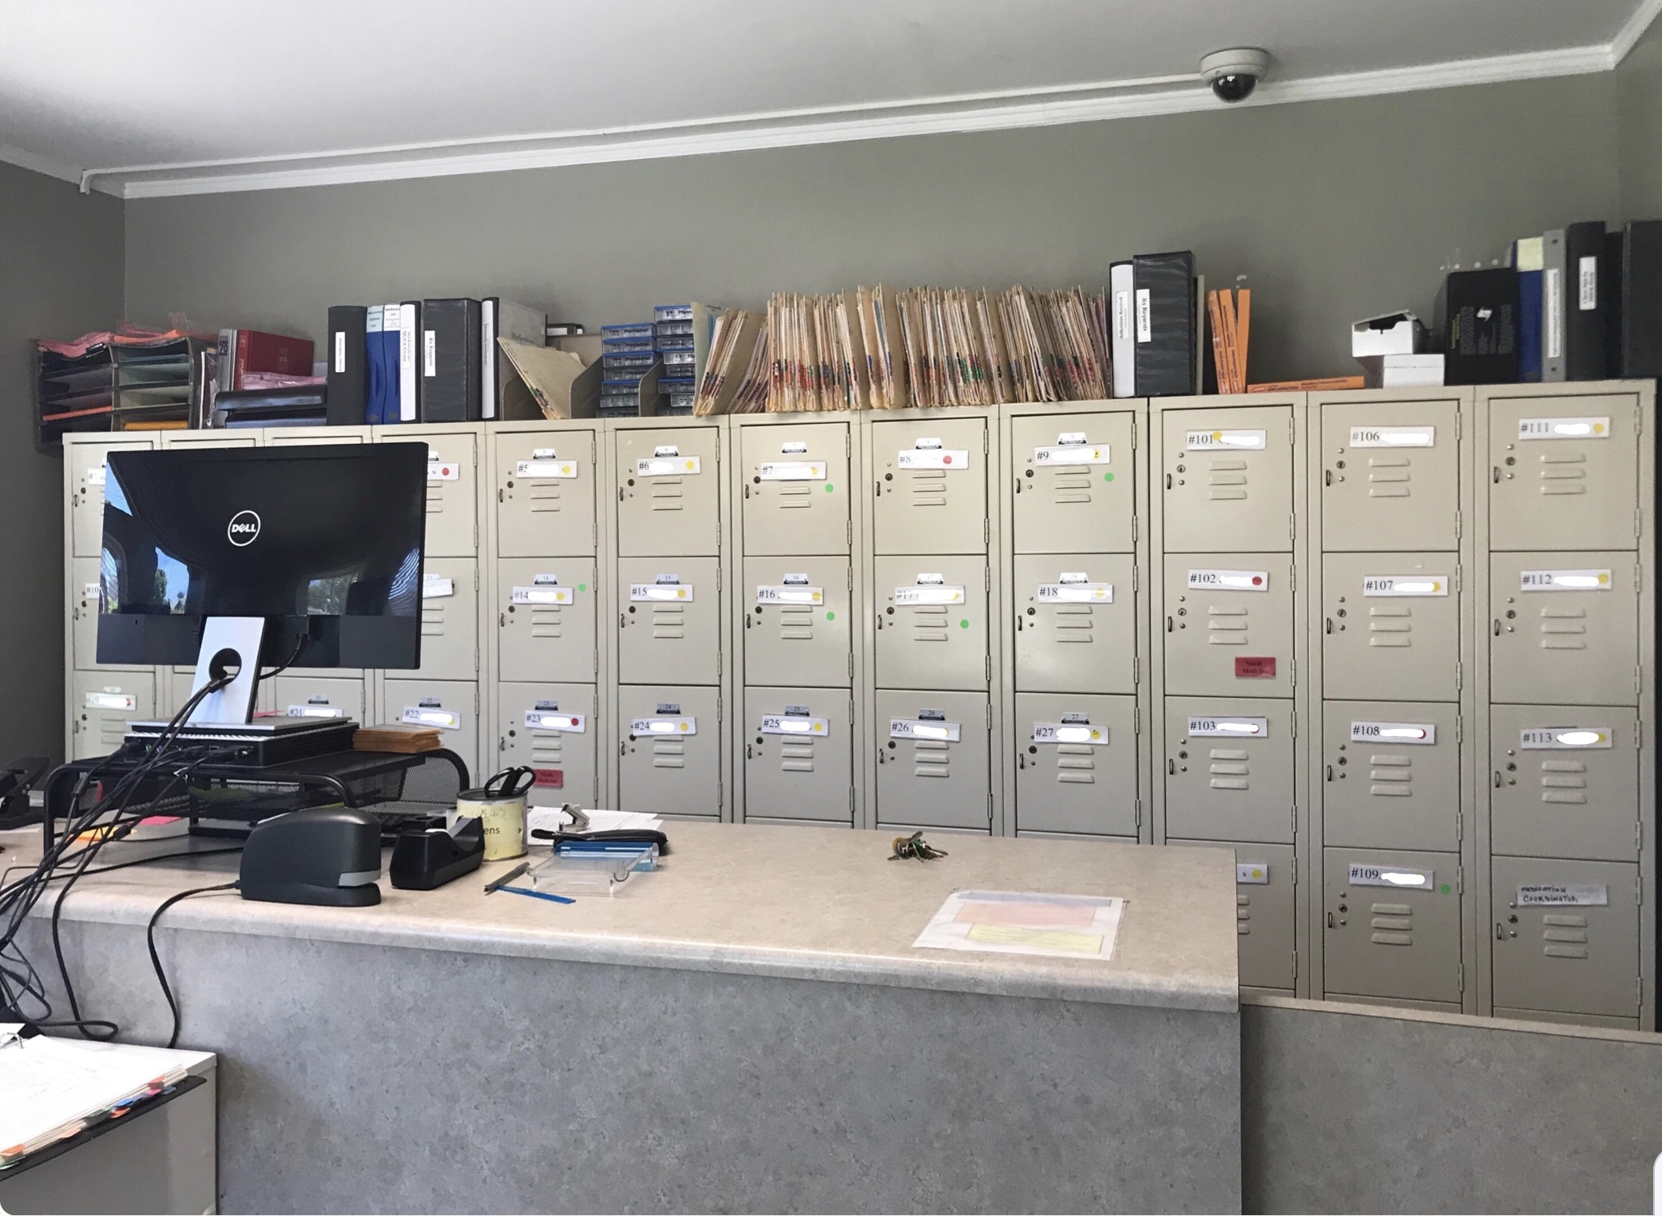
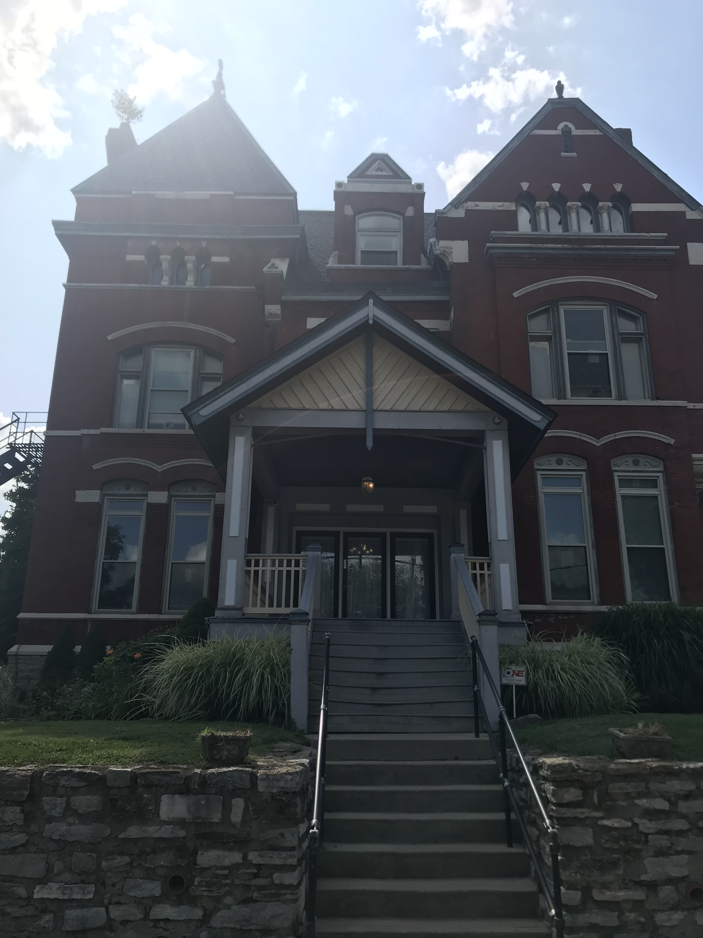
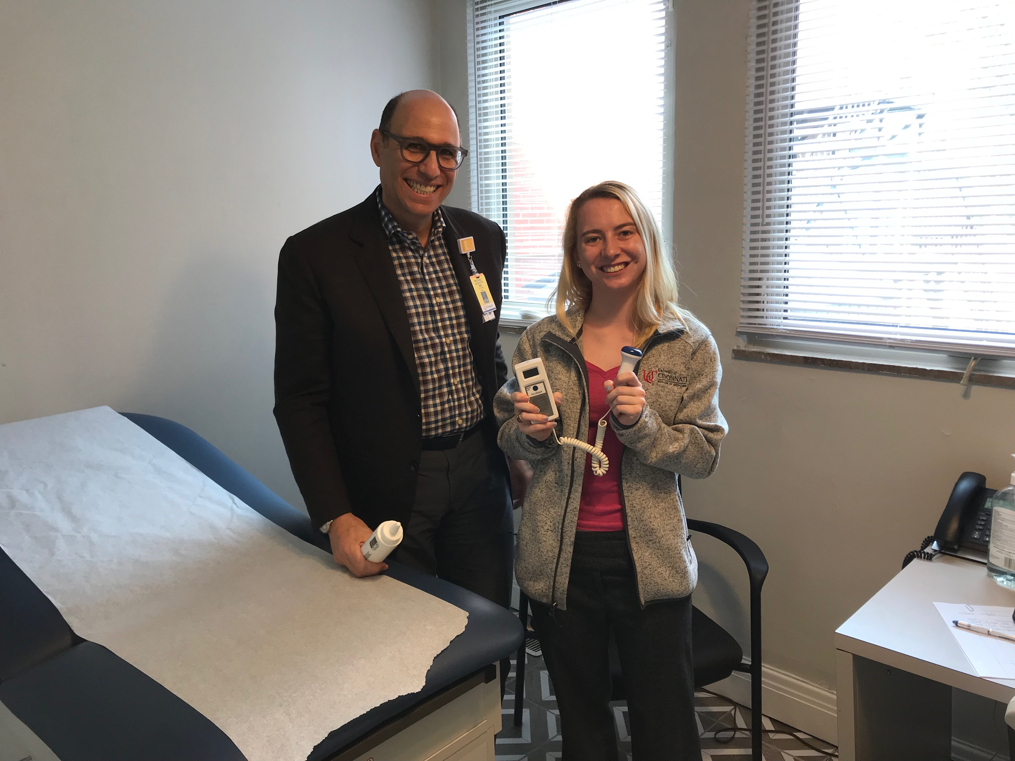
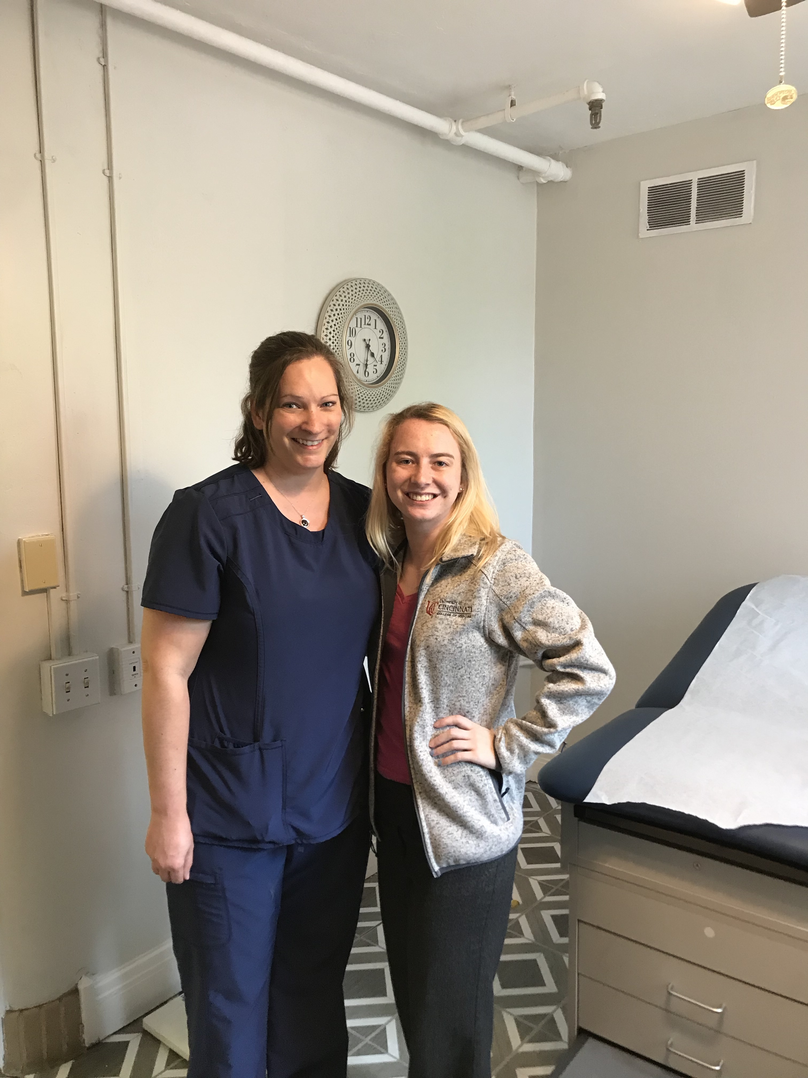
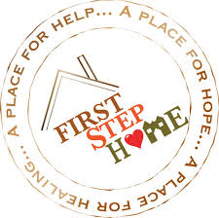
Healthcare Assistance and Integrating Physical and Mental Health Exercises in Early Addiction Recovery
Bridget A. Watson
Urban Health Project 2019, University of Cincinnati College of Medicine
About First Step Home
Founded in 1993, First Step Home is a treatment center located in Walnut Hills, a suburb of Cincinnati. Established as a women’s only facility, First Step Home is the only addiction treatment center in Cincinnati allowing children, up to the age of 12, to live with their mother’s while they are in treatment. First Step Home provides an entire continuum of care to women with addiction. The staff work to assist women in rebuilding their families as they break the cycle of drug and alcohol addiction.
Mission:
To empower women to overcome substance abuse disorders so that they can achieve self-sufficiency and provide a safe and nurturing environment for their children.
Treatment Programs:
Residential Treatment
Intensive Outpatient Treatment
Outpatient Treatment
Maternal Addiction Program
Treatment Services:
Group counseling
Individual therapy
Family therapy
Medication Management
Medical Nursing Support
Child Care Services
Transportation Services
Case management
Peer Support
UHP Intern Responsibilities
As an intern at FSH this summer, I spent most of my time in 3 main areas: the medication room, working with Dr. Marcotte, and assisting nurse Jen. I helped administer medication in the med room sometimes during the morning rush or in the afternoon in time for dinner meds. During my internship I learned the ins and outs of medication assisted treatment (MAT), which is an integral part of the recovery of many women at FSH. A large part of my job in the med room is utilizing active listening with the clients, as this is a time when I get to see the clients one on one and many of them open up to me about their various situations.
There are 3 main options of maintenance drugs used to treat opioid addiction:
methadone – clinic-based opioid agonist that does not block other narcotics while preventing withdrawal while taking it; daily liquid dispensed only in specialty regulated clinics
naltrexone – office-based non-addictive opioid antagonist that blocks the effects of other narcotics; daily pill or monthly injection
buprenorphine – office-based opioid agonist/ antagonist that blocks other narcotics while reducing withdrawal risk; daily dissolving tablet, cheek film, or 6-month implant under the skin
Working with the OBGYN
My favorite part of my internship at FSH has been working with the new medical staff, particularly nurse Jen and Dr. Marcotte. Each day I would report to nurse Jen, assisting her with various tasks like tracking down certain clients, distributing transportation passes, and checking blood pressures. On Mondays and Fridays, Dr. Marcotte spends the afternoon first in his maternal health group that I participated in a few times. He then sees each pregnant patient once a week for a vitals check, discussion about any concerns, and listening to the fetal heartbeat.
Dr. Marcotte taught me how to do Leopold’s maneuvers to determine the position of the fetus’ head, back, and butt in order to estimate where the heartbeat can be found, which we listen to with a doppler ultrasound device. Dr. Marcotte taught me how to count the speed of the heart rate, although he can know the speed just by listening for a few seconds. I am very thankful to Dr. Marcotte for allowing me to actively participate in these weekly visits with his patients who trust him so much. I was able to learn a lot about the clients and how big of a role their health as a future mother and the health of their child plays in their recovery. For many of them, pregnancy was the single deciding factor that led them to FSH seeking a sober life. Although I have not learned the reproduction curriculum in school yet, I was able to pool outside resources and teach myself as the summer went along, with the guidance of Dr. Marcotte. In the past I had always been fiercely interested in neurology, but this summer internship experience has opened my eyes to the OBGYN field and I could really see myself enjoying this as a career.
My Project
My project funded a few items that aim to enhance the lifestyle at First Step Home for both the women and their children. This past week the doctor and I saw a couple patients who have little children and entertaining them quietly during their visit proved to be a challenge. As part of my project, I purchased coloring books and pencils that can be used in the future, to prevent the little ones from playing with the medical equipment and allowing the focus to be on mom during her visit with the doctor. Furthermore, a couple weeks ago I led a group with the women about the importance of establishing exercise as a new healthy coping mechanism early in recovery. Specifically, I educated the women about how exercise activates the brain’s natural reward system, releasing endogenous opioids such as endorphins. The impact of exercise on substance use disorder is powerful: people who exercise are 4x more likely to abstain from drugs and experience 1.7x less withdrawal symptoms. For most, if not all, of the women, their substance use was a coping mechanism that was numbing issues in their life that did not just go away when they quit using. Therefore, it is important the women are able to initiate new healthy habits like exercise to become active coping strategies. However, at the time of my exercise class, the women had access to zero exercise equipment. It was difficult to encourage the residents to exercise when they had nothing to work with, so my project funded yoga mats, a few free weights, and resistance bands. It is a small step in the right direction and I hope that FSH will follow my lead and establish more of a space to keep this equipment and expand. Lastly, I bought ear plugs to benefit the women who have roommates, which is the majority of them, and essential oils. I hope to teach a class about mindfulness and mental health before my internship ends in which I will educate them about the usefulness of essential oils and other mindfulness techniques like meditation.
Residents who are prescribed buprenorphine or naltrexone come to the medication room daily and, until recently, most MAT prescriptions were being written at Brightview, another treatment center. This summer Dr. Marcotte initiated FSH’s own buprenorphine clinic in which he has slowly taken on more patients, lessening the amount of women who need transportation passes and/or are missing group to go to Brightview. I have assisted nurse Jen in organizing the patients who wanted to switch MAT providers and have participated in the visits with these clients. I also helped nurse Jen figure out the various tests we need to administer first, such as pregnancy tests and HIV testing.

